Slide 1


Lending club default rate on loans
By Masood Khan

Slide 2
Introduction-
This is an Exploratory Data Analysis of Loan Data set. The dataset contains information about loan issued through 2015-2018. The data also required cleaning and data preparation processes such has removing irrelevant and redundant variables, columns having lots of NA values.
A business problem has been identified and they are concerned about the default rate on their loans. They want to understand who is likely to default and who they should lend to in the future.
The analysis to create a decision-making granting loans is one of the most important operations for financial institutions. By considering past results of a pertain, a model is trained to accurately predict future outcomes of individual loan approval success rate.

Slide 3
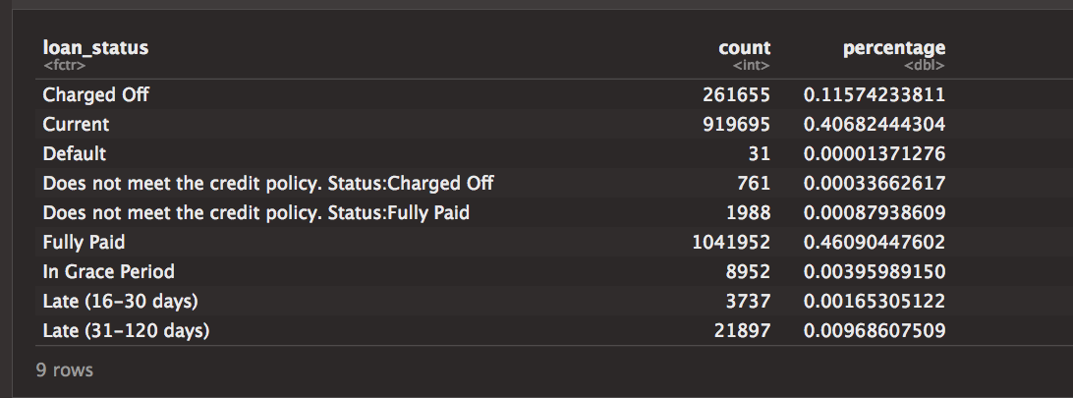
Exploratory Data Analysis
The variable Loan status has 9 categories
To answer the business question about default rates I have only considered the data from Fully paid and Charged off (default) category.

Slide 4
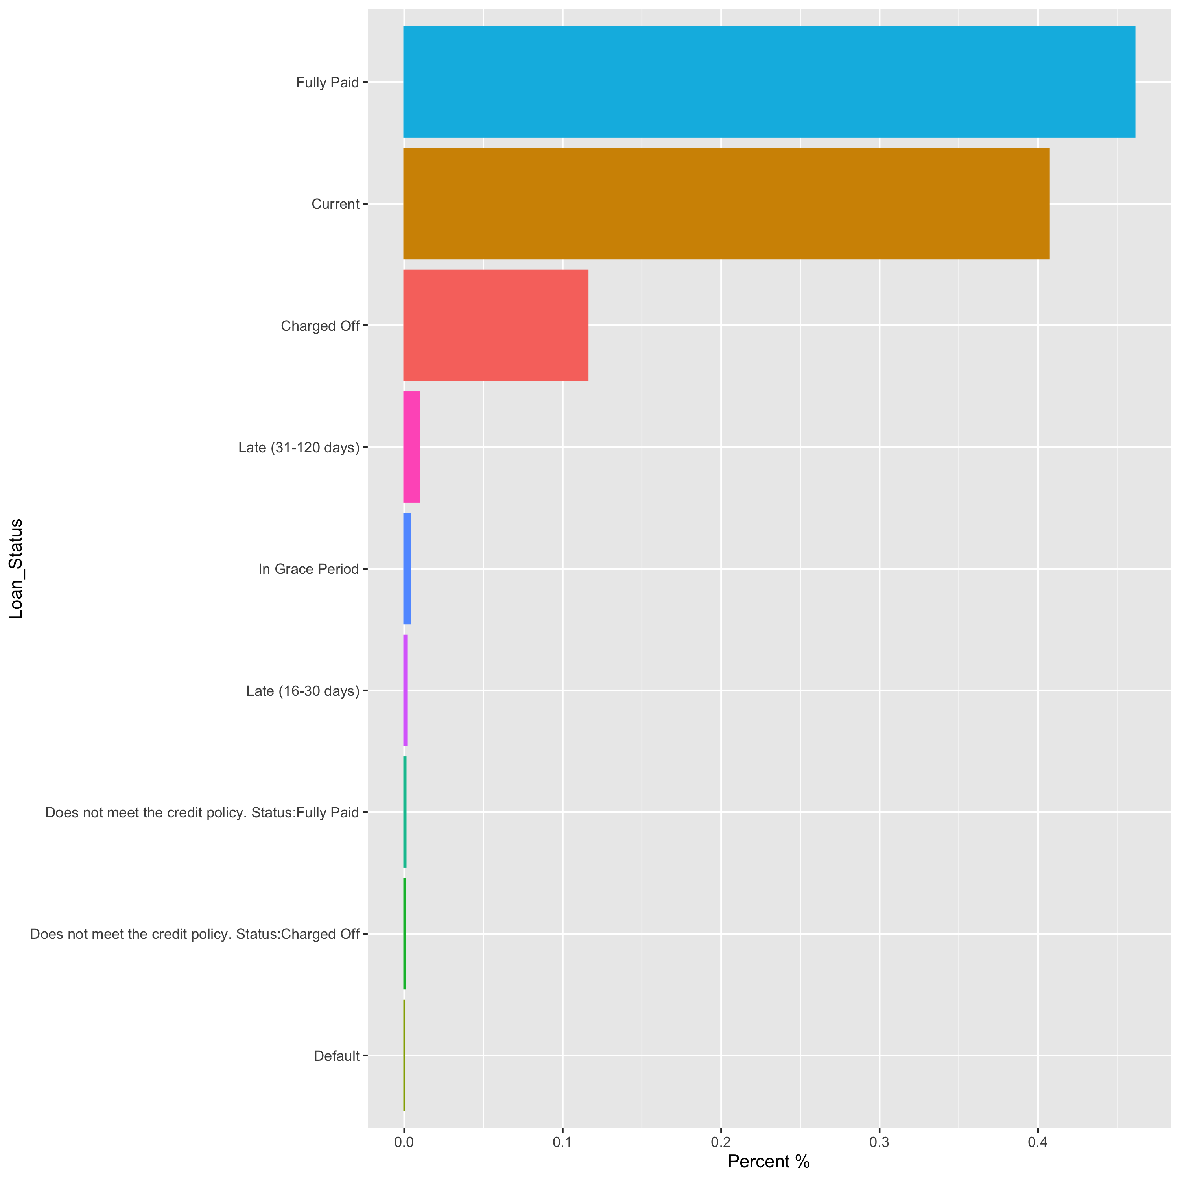

Slide 5
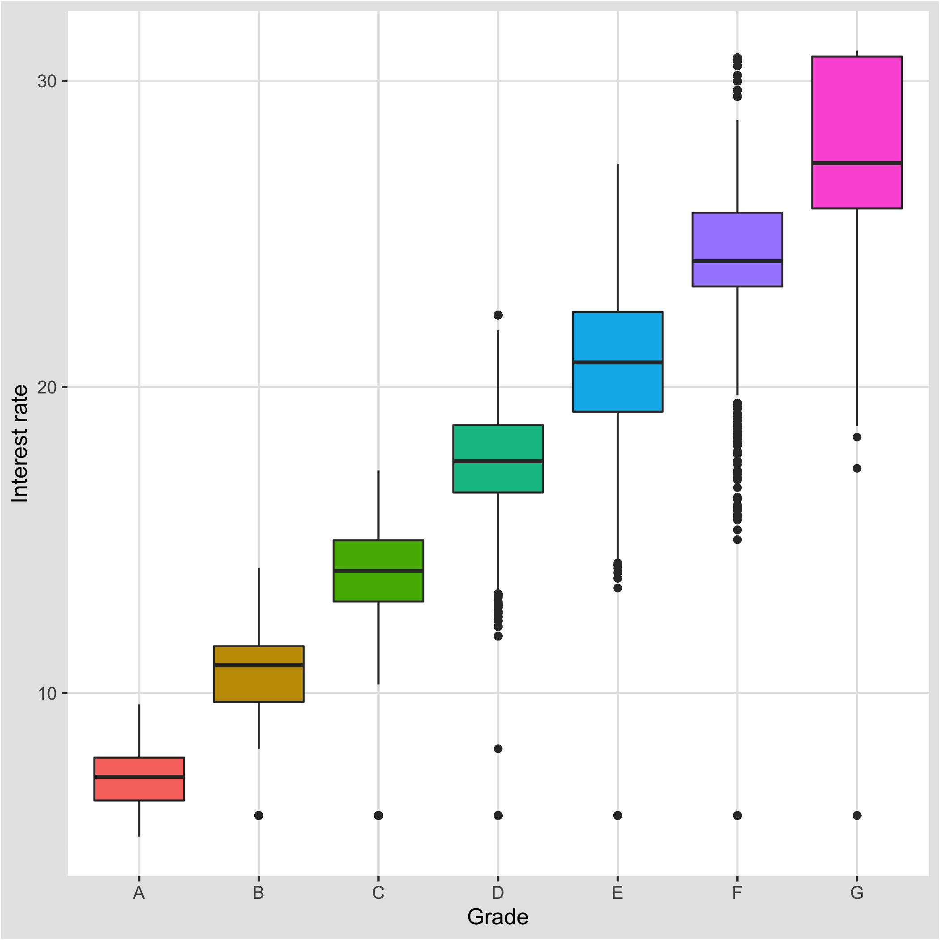
Univariate analysis on Categorical variables
For credit risk modelling It is known that the better the grade the lowest the interest rate.
Lending Club also assigned a grade (A–G) to each note that reflects Lending Club's assessment of the credit risk of the corresponding loan.

Slide 6
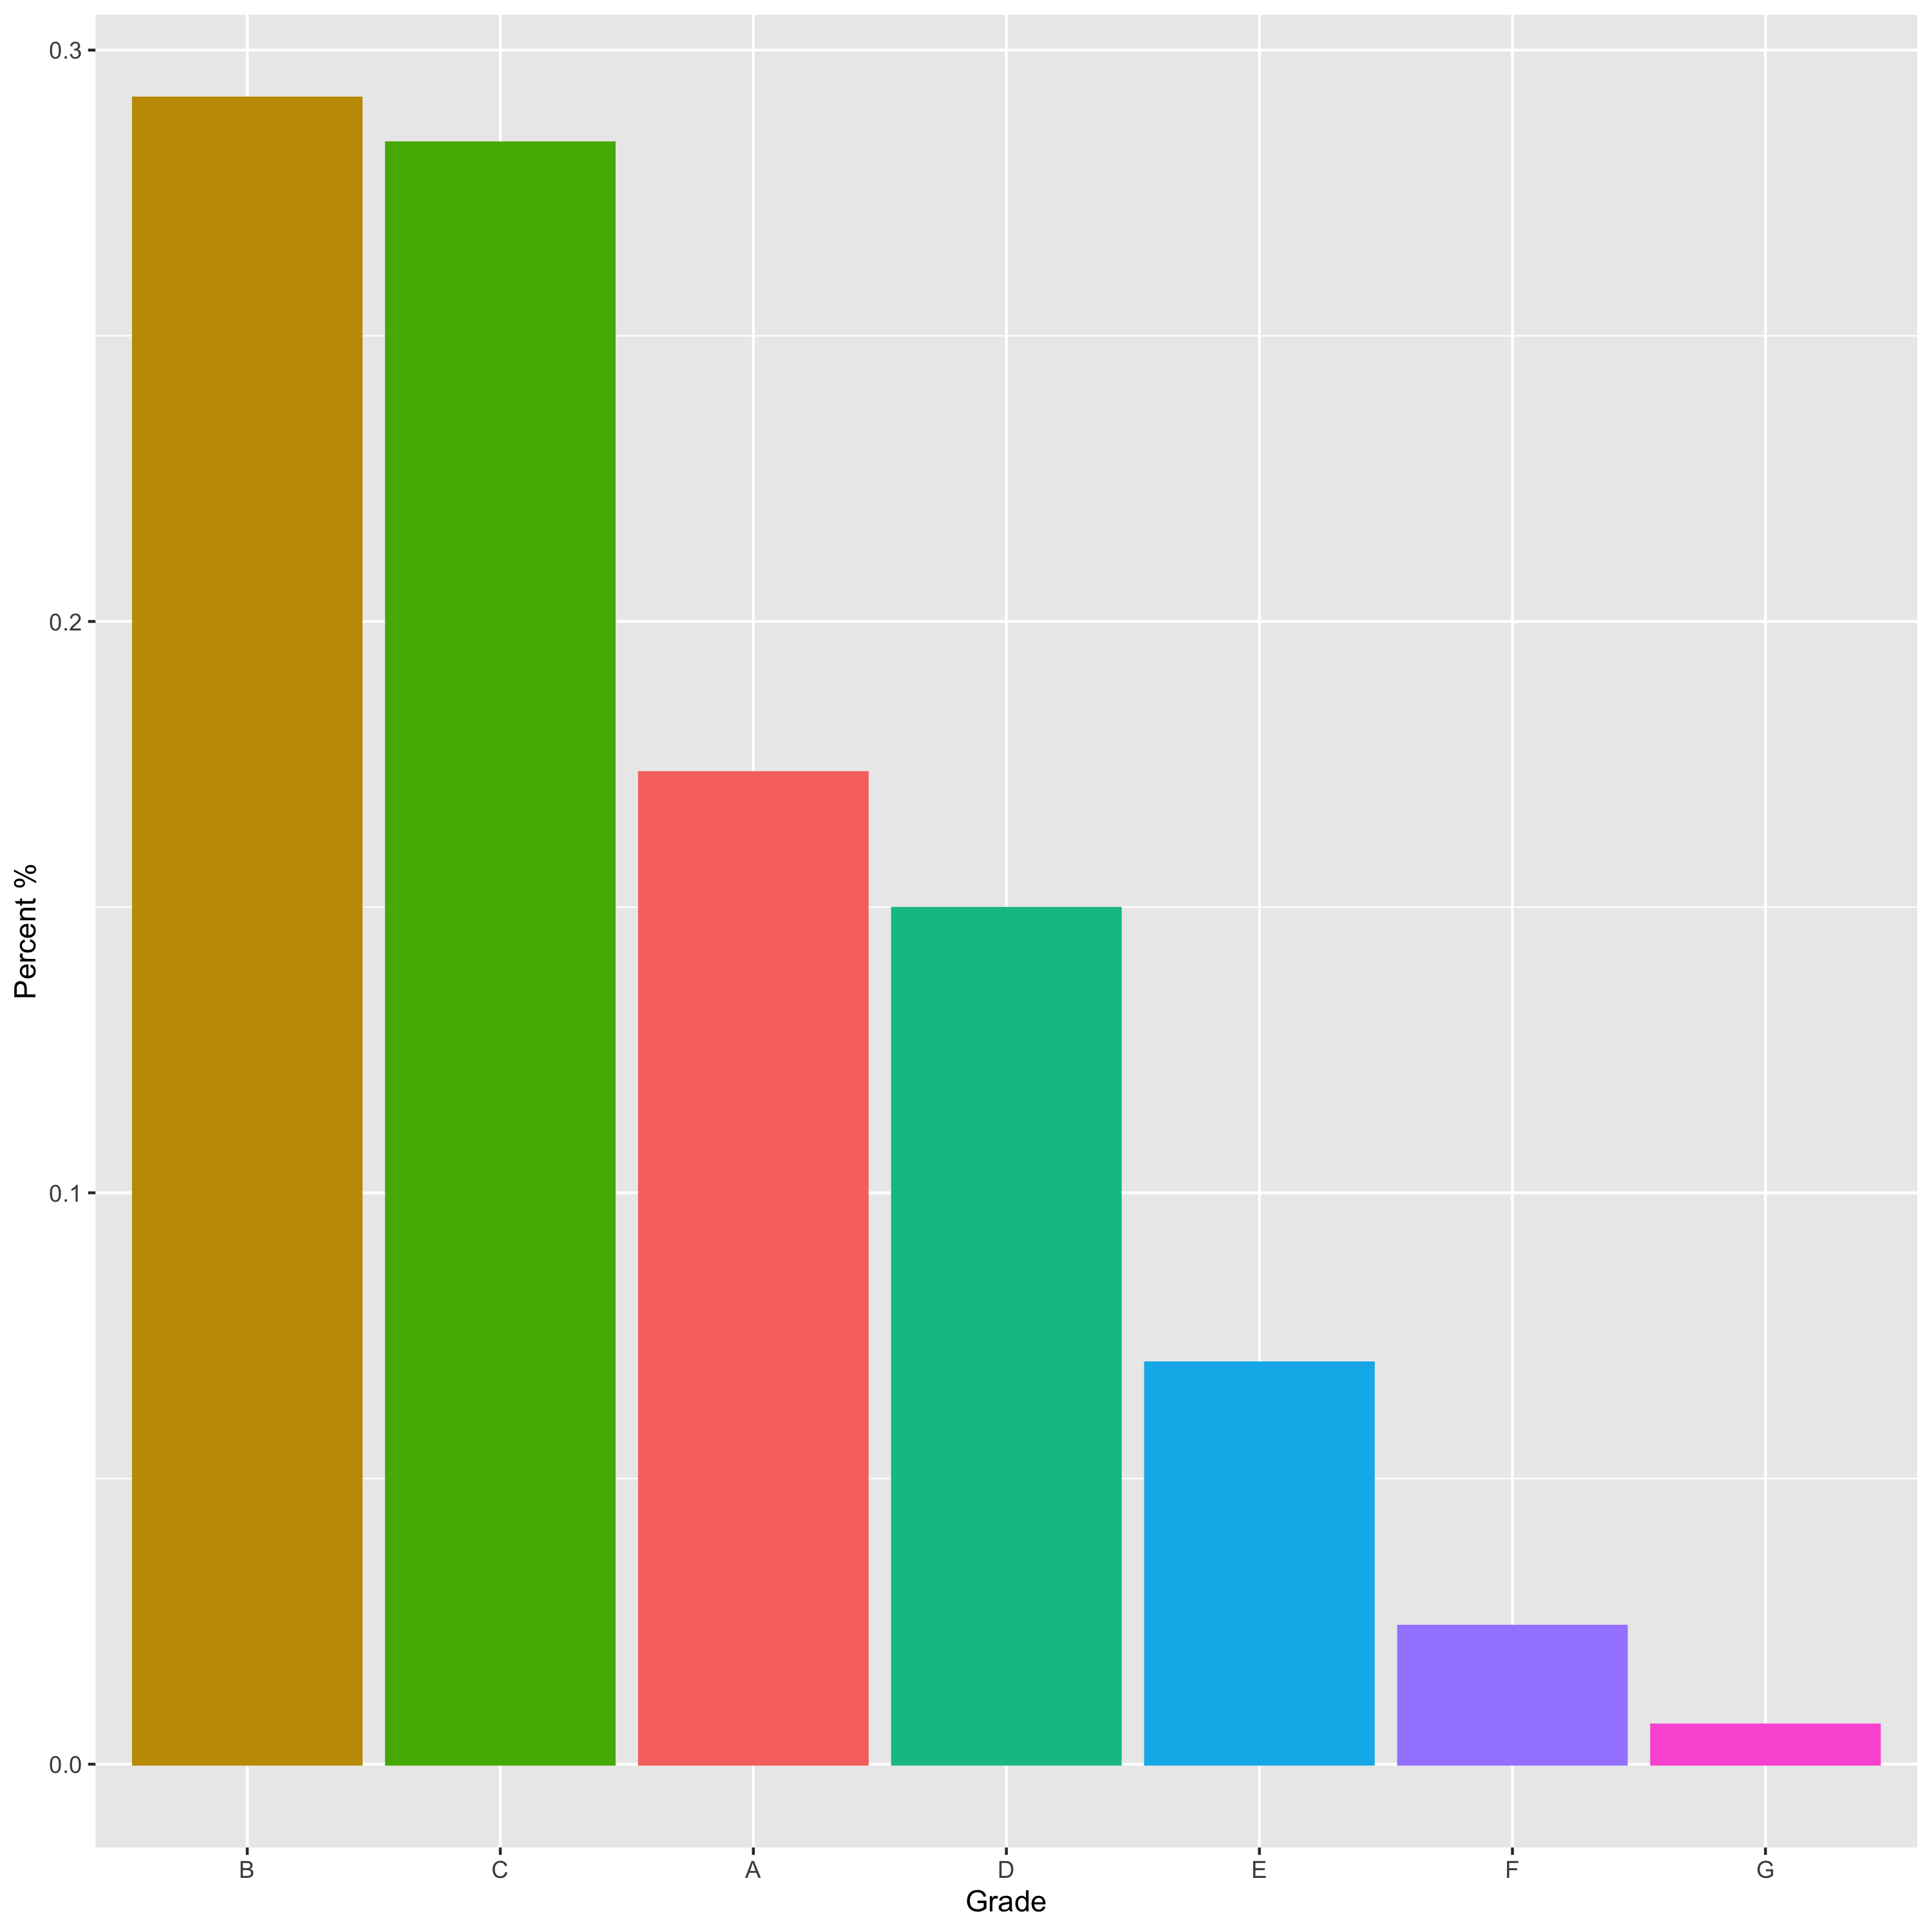
Percentage of the loan assigned according to grade by the Lending Club
Grade B and C are assigned to more than 50% of the total loans.

Slide 7
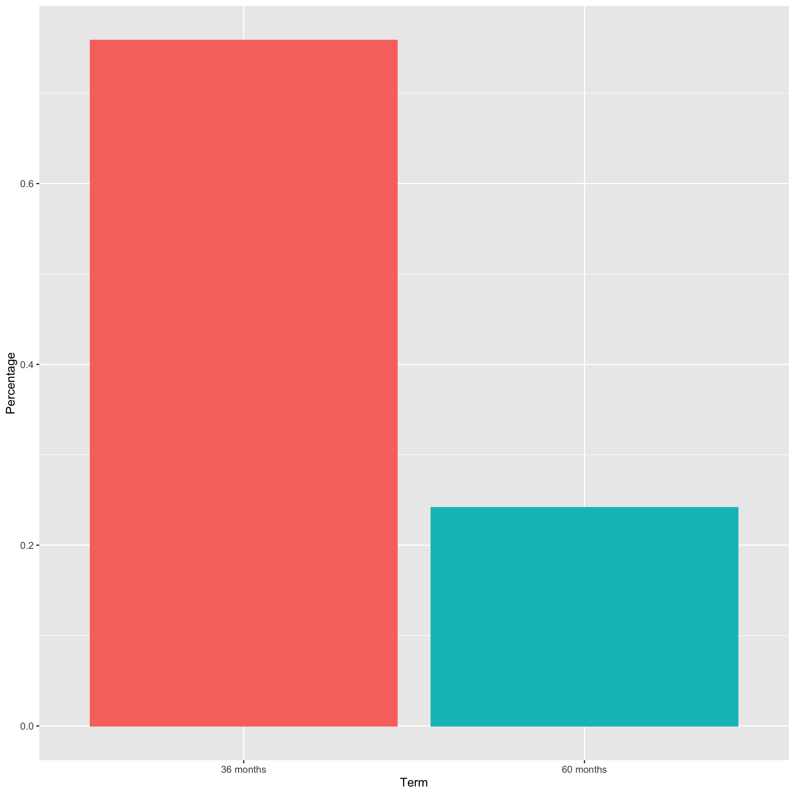
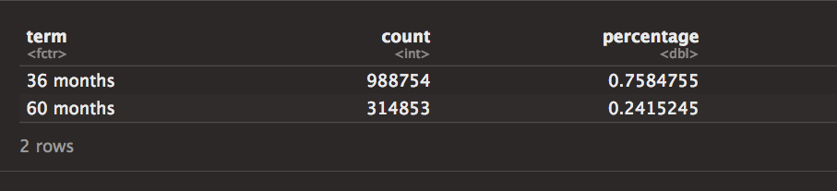
TERM:
This is the number of payments on the loan. There are two terms (36 months and 60 months) on which loans are given.
Around 75% of the loans are given on 36 months term

Slide 8
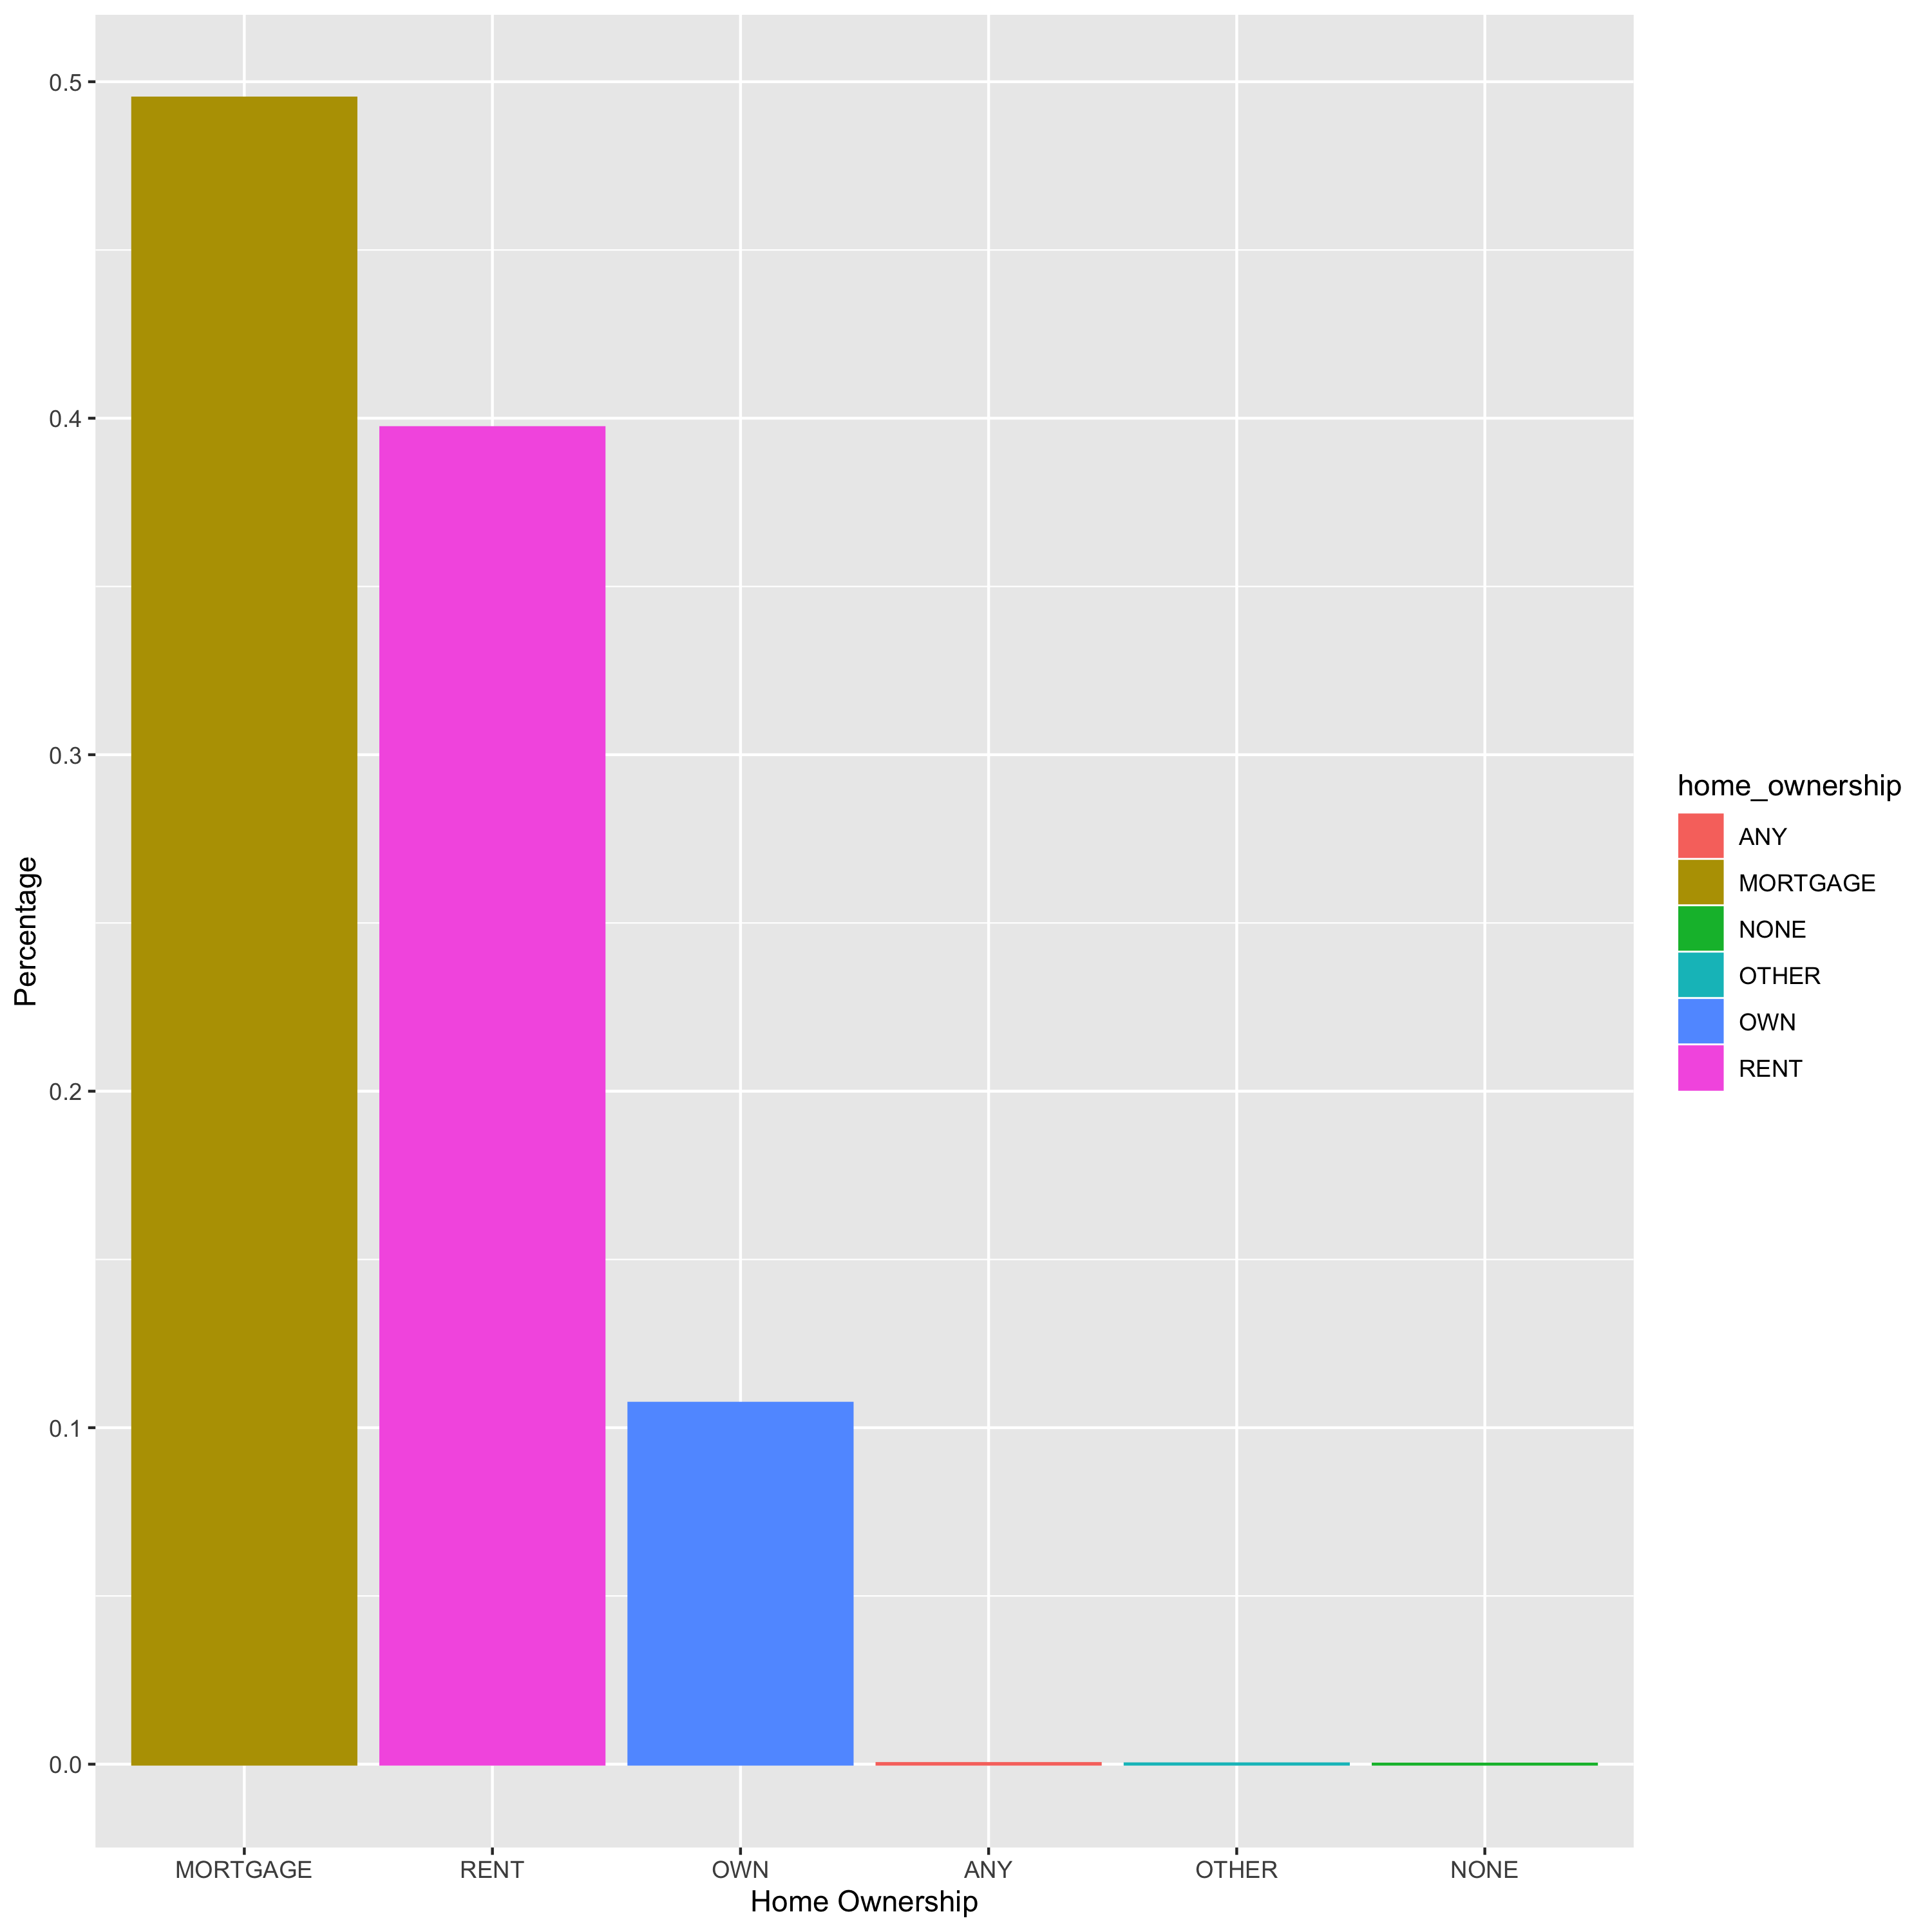
Home Ownerships:
Rent and mortgage homeowners account for around 90% of the loans

Slide 9
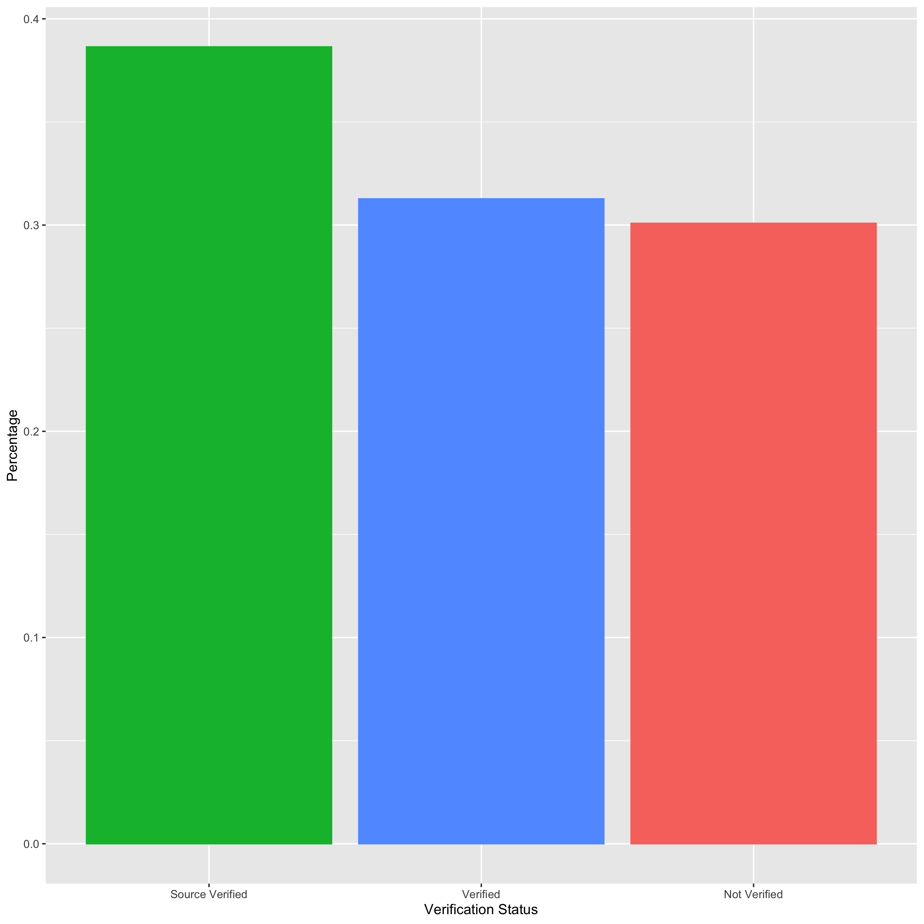
Verifications:
More than 65% of the loans are verified before lending

Slide 10
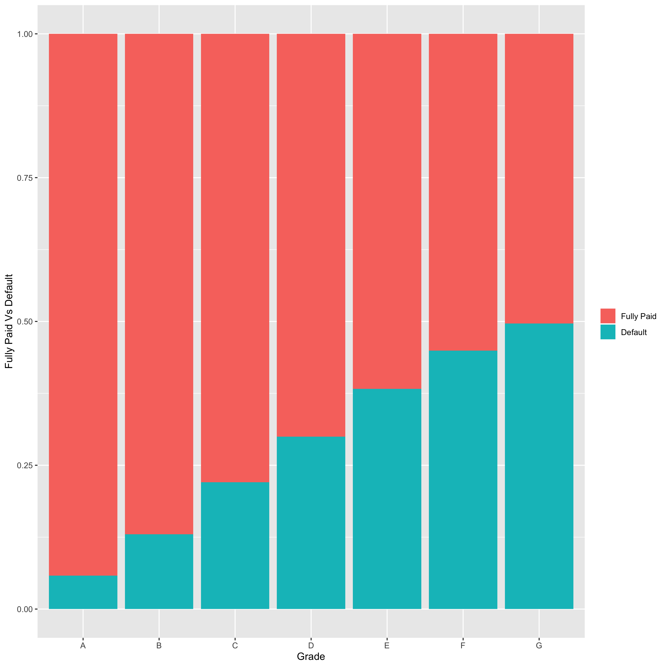
Default increases with increase in Grade from A-G, which clearly indicates that a loan with grade A means lowest risk of loan default and G means higher risk of loan default.

Slide 11
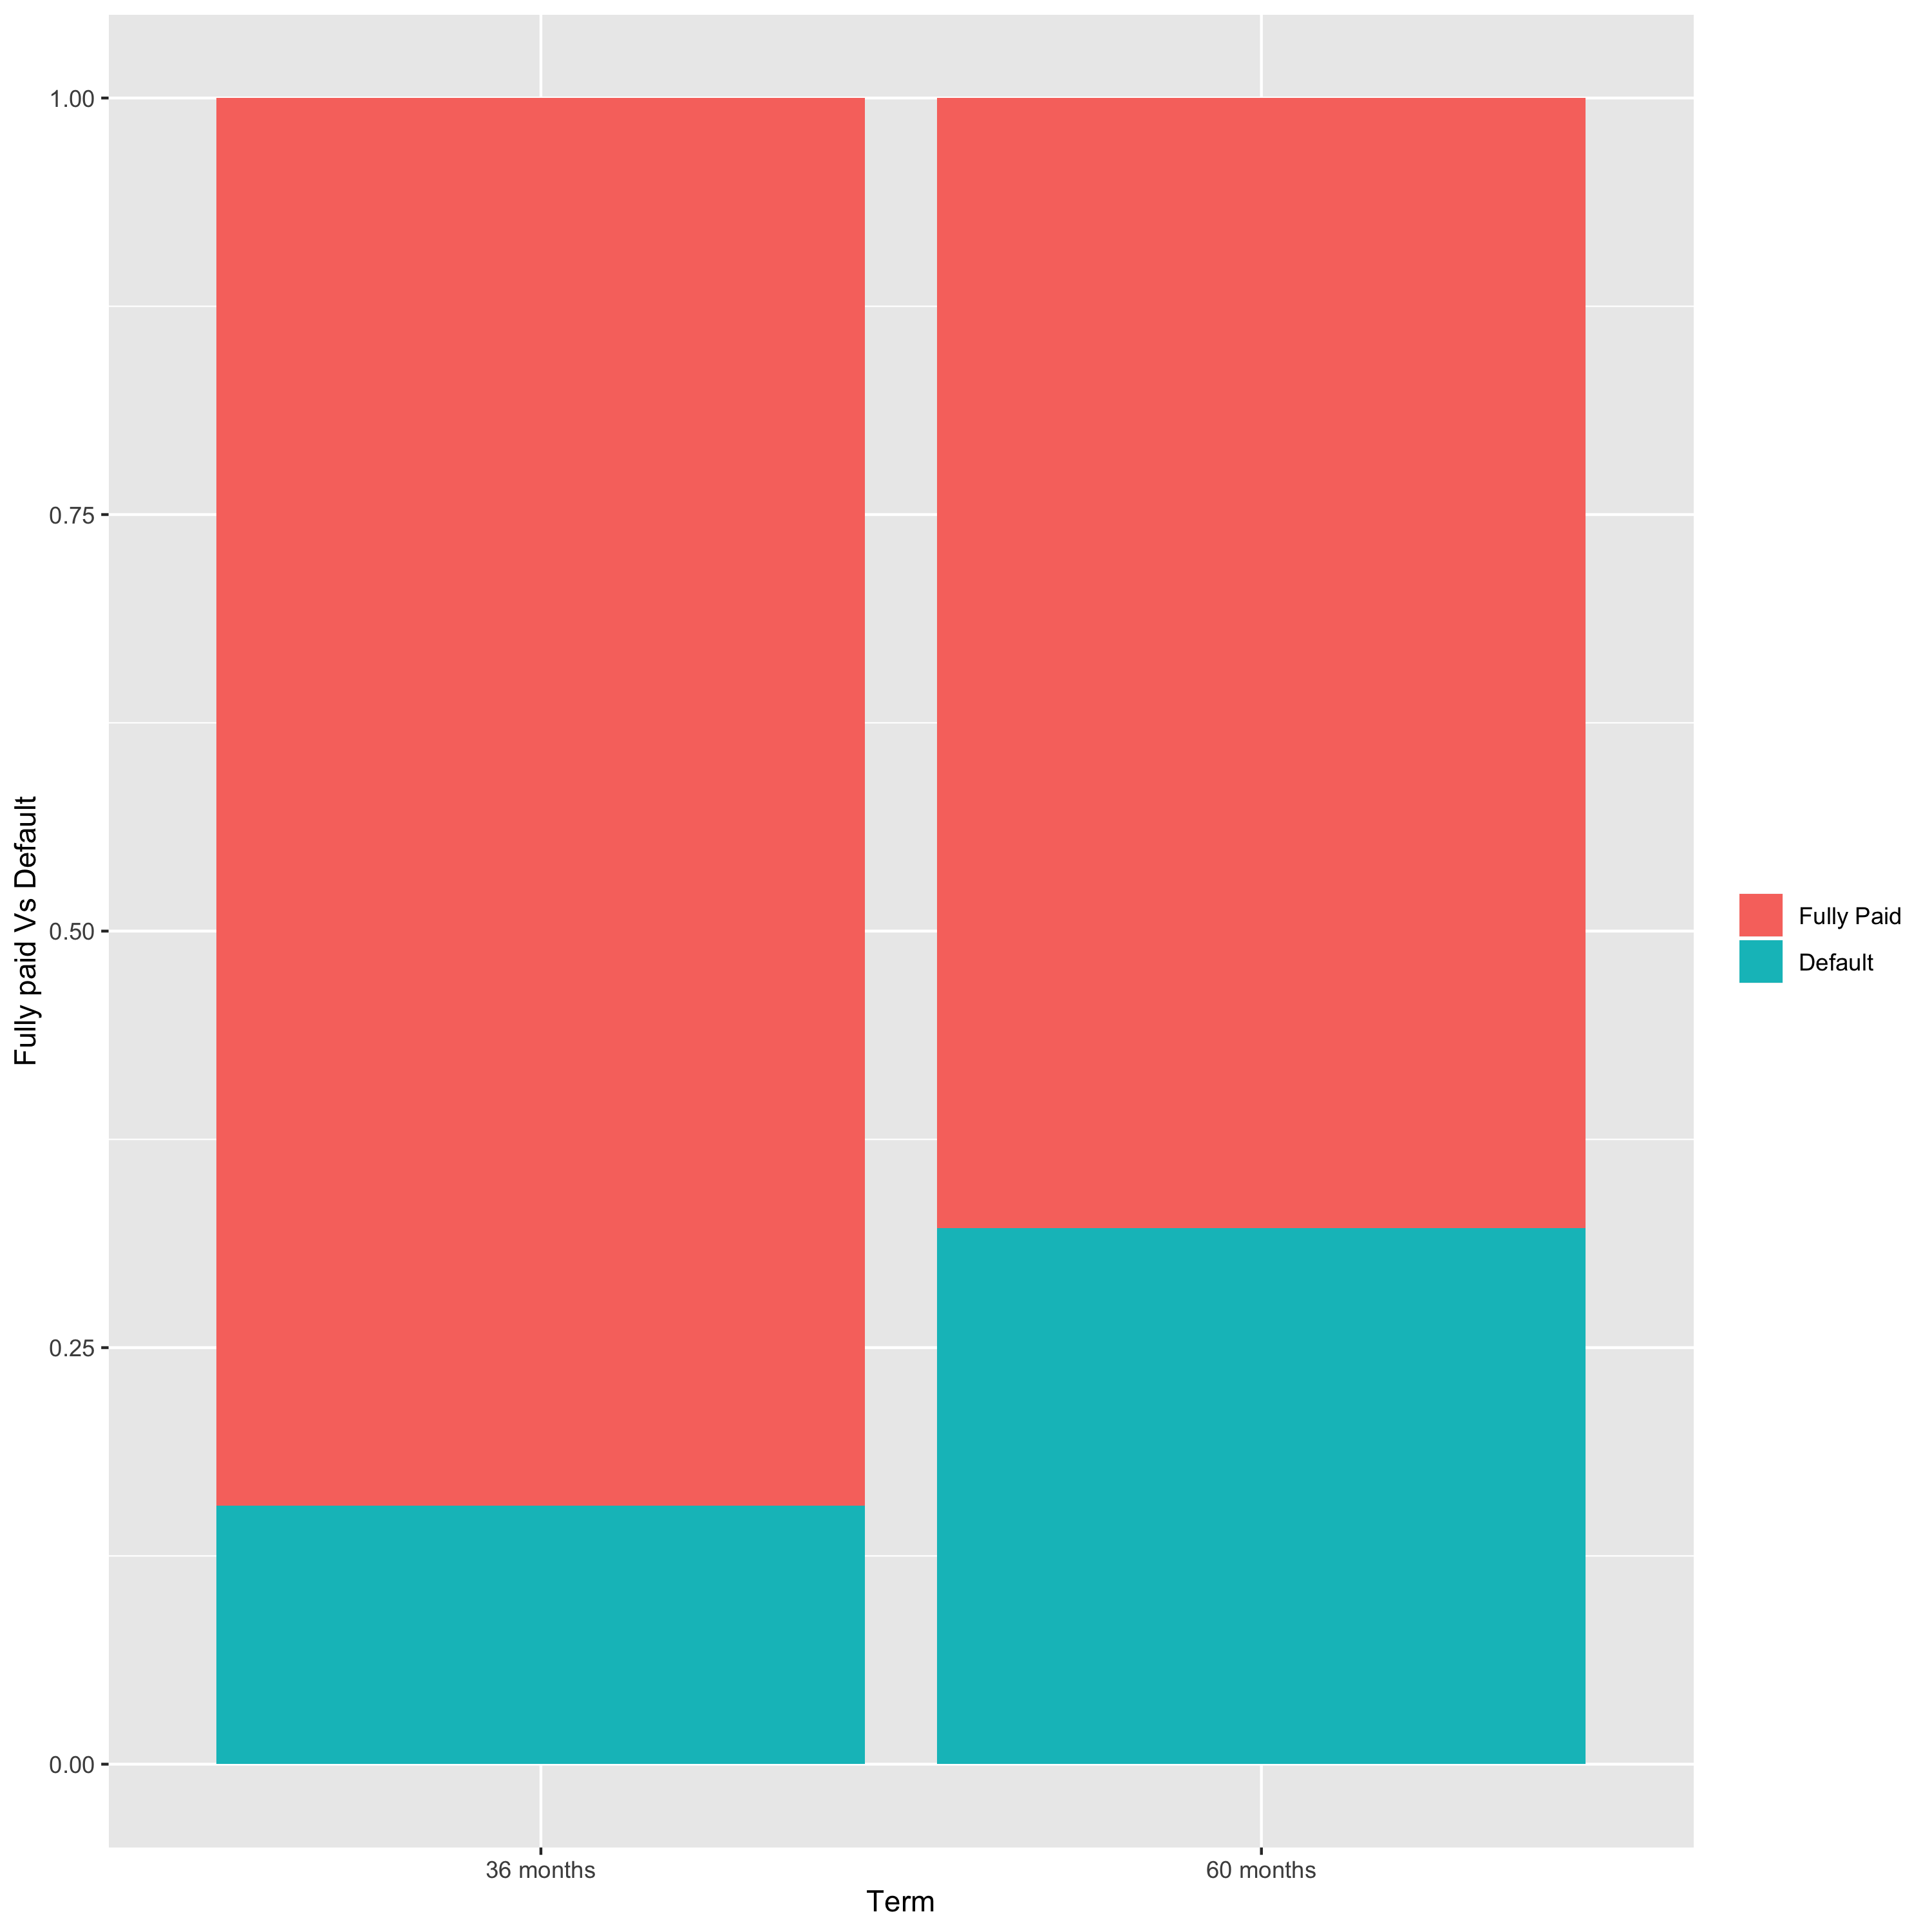
Default with respect to Term: The percentage of default in case of loans with 60 months term is higher as compared to the loans with 36 months term.

Slide 12
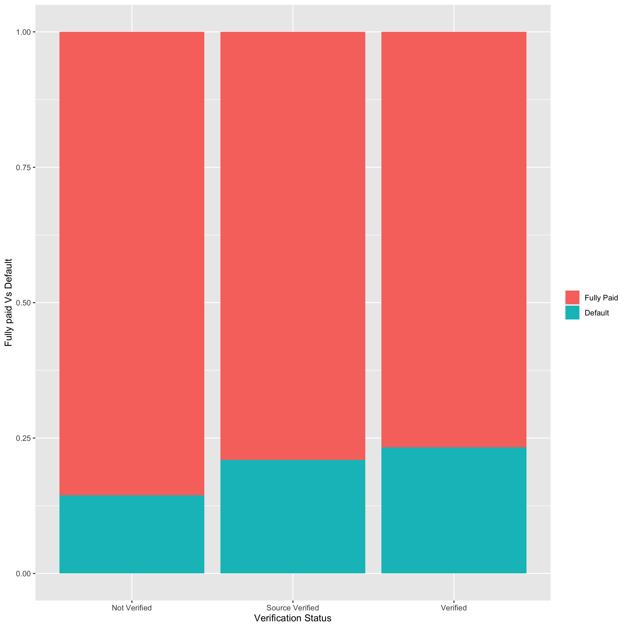
Verification status with respect to default:
The default rate in verified category is slightly more than non verified categories

Slide 13
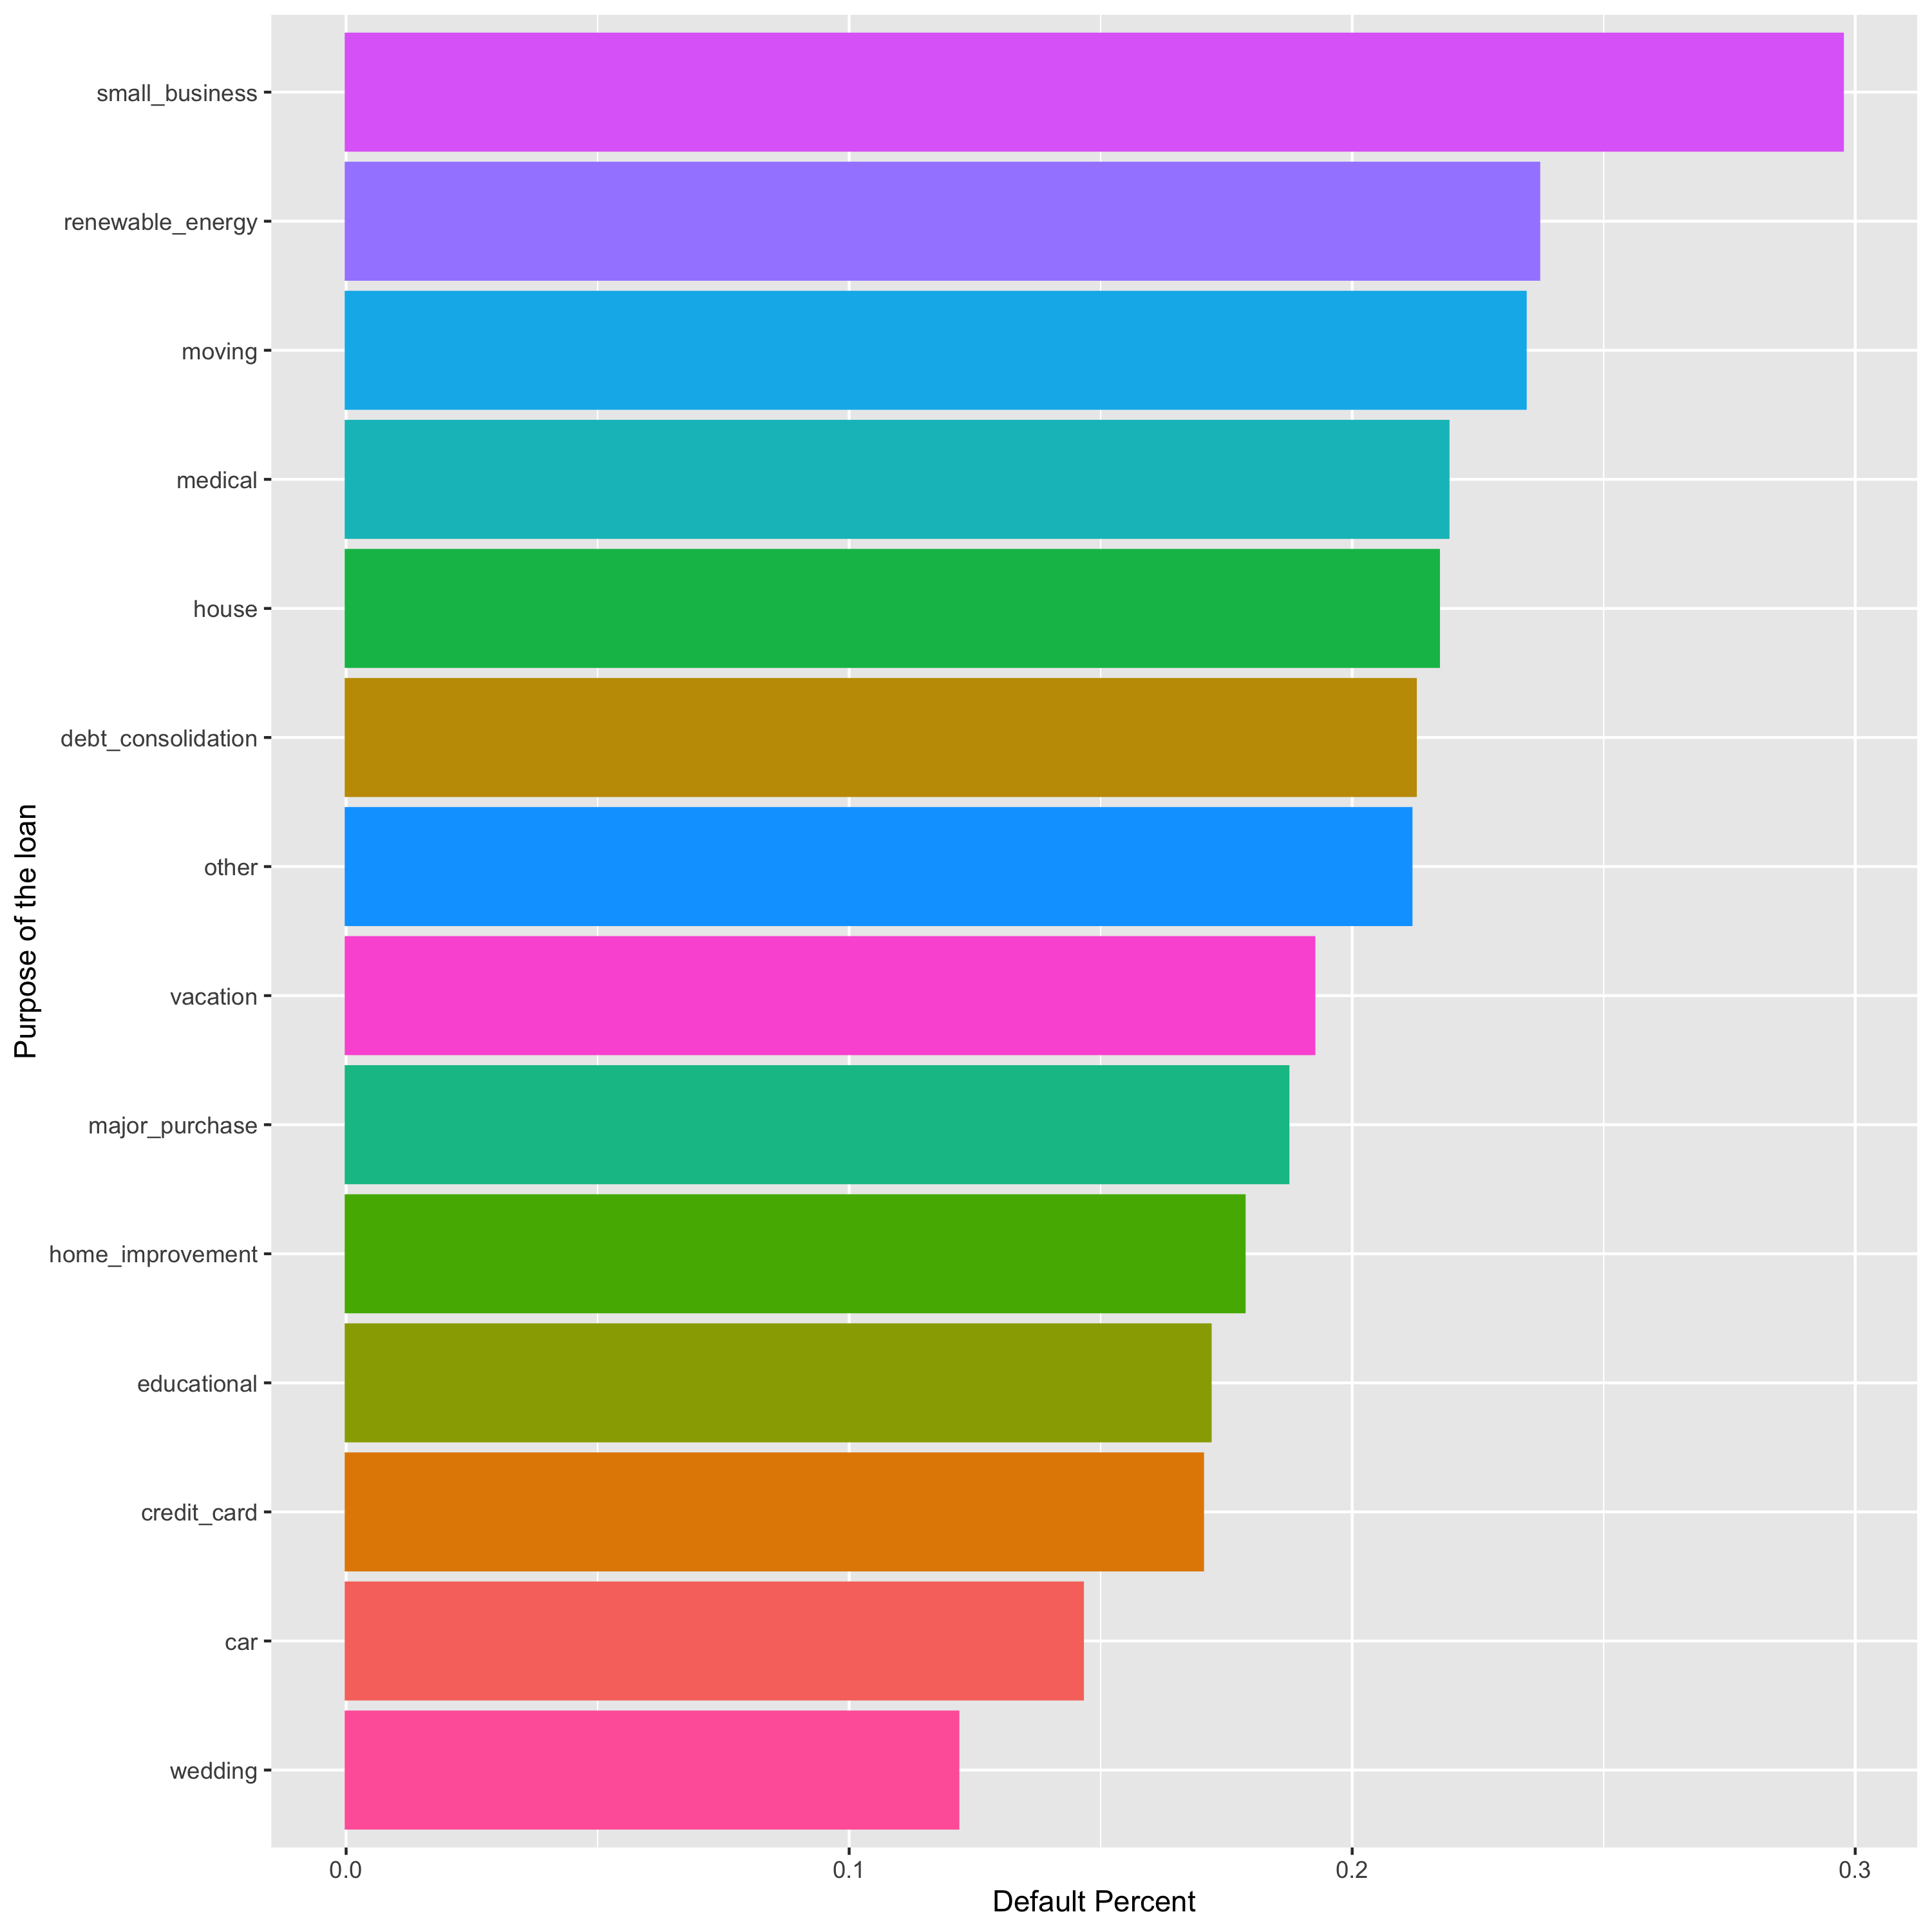
Purpose of Loan with respect to Default:
The default rate in small business category is highest as compared to other categories.

Slide 14
Data modelling
Modelling Process:
I have created the column binary_loan_status which will be our response variable.
I have exclude some independent variables in order to make the model simpler.
The dataset split to training (75%) and testing (25%) for the validation.
Train a model to predict the probability of default.
Because of the binary response variable, I have used logistic regression, which models the probability that Y belongs to a particular category, in this case the probability of a non-performing loan.

Slide 15

The coefficients of the following features are positive:
Loan amount, Interest Rate, Home Ownership – Other, Term
The better the grade are less likely to be default
This means the probability of defaulting on the given credit varies directly with these factors. For example more the given amount of the loan, more the risk of losing credit.
The coefficients of the following features are negative:
Annual Income, Home Ownership – Own, Home Ownership - Rent
Borrowers with 10+ years of experience are more likely to pay their debt
There is no significant difference in the early years of employment
This means that the probability of defaulting is inversely proportional to the factors mentioned above.

Slide 16
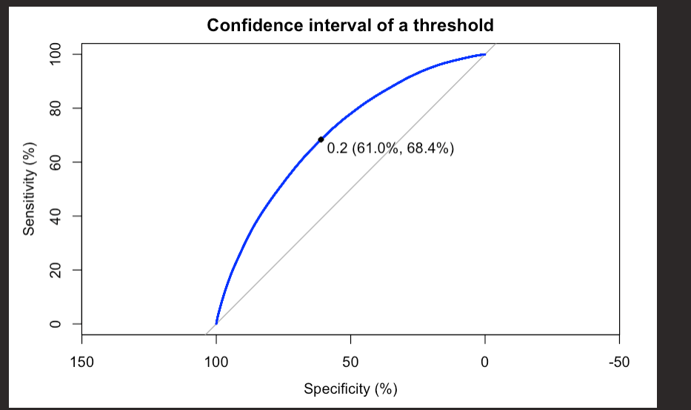
A logistic regression model was used to predict the loan status.
Different cut off’s were used to decide if the loan should be granted or not. Cut off of 30% gave a good accuracy of 76.22%.
The decision to set a cut off is arbitrary and higher levels of threshold increases the risk. The Area Under Curve also gives a measure of accuracy, which came out to be 70.25%.

Slide 17

Conclusion:
A lender must consider the following variables while deciding whether to Loan or not,
High interest rate- The interest rate increases with increase in loan amount leading to higher chances of default
Grade- When a person is assigned Grade A, the risk of default is lowest and G grade shows the risk of default is highest. This is because interest rate increase from A-G
Term- default rate is high on 60 months term
While debt consolidation is the main purpose for borrowing money, the default rate is high in case of small business category
Default rate increases when income increases from low to high income groups.

